Slide 1


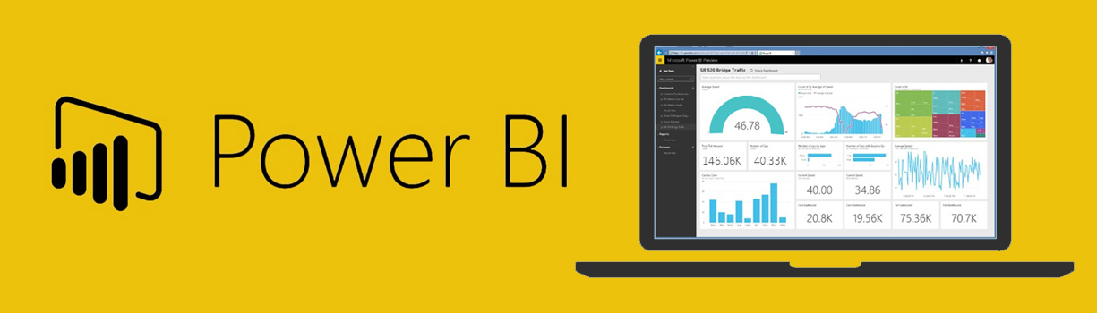
Combine Python with Power BI Rónai Bertalan BI DEVELOPER
Grape Solutions Zrt.
Notes:
https://www.linkedin.com/in/ronaibertalan/
https://grape.hu/en/
https://www.linkedin.com/company/grape
Hungarian Python meetup group https://www.meetup.com/budapest-py/events/255415841/

Slide 2
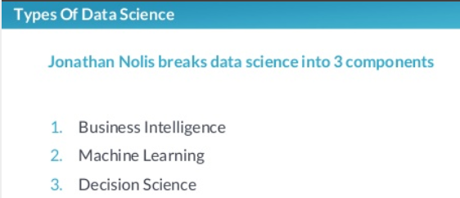
http://datascientistbudapest.com
What data scientists really do, according to 50 data scientists from
Hugo Bowne-Anderson
Notes:
https://www.slideshare.net/HugoBowneAnderson/what-data-scientists-really-do-according-to-50-data-scientists?fbclid=IwAR30NQSq_pgpt0hSGWmI9cQStd3kl-a2ww-FP1zNkMjZubjrExcScIbvgFU
Python Data Scientist track
https://www.datacamp.com/home
Tell them about that lots of info are on the notes so they should download it from Github.

Slide 3
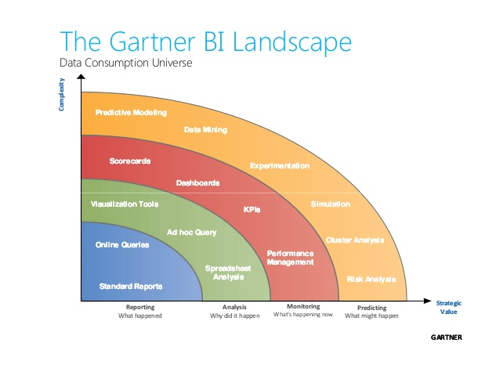
Business Intelligence
Notes:
The Prediction level is reached by data science.
Picture source: https://www.slideshare.net/sogeti_nl/bi-symposium-pyramid-28603122

Slide 4
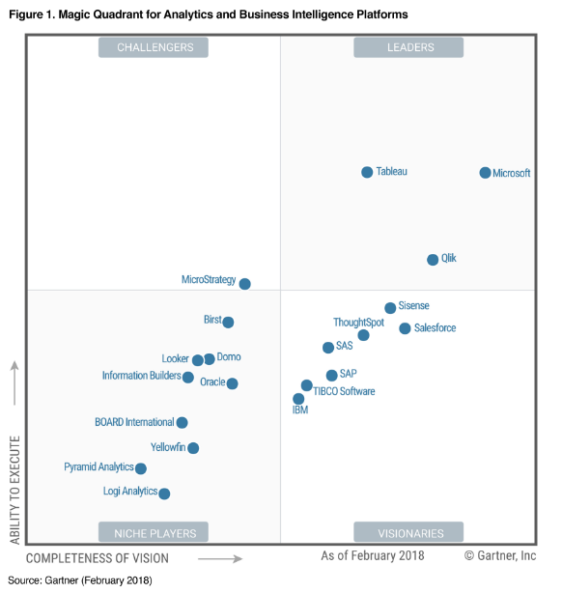
The Gartner BI Landscape
Notes:
The three most important reporting tools are in the leaders square.

Slide 5
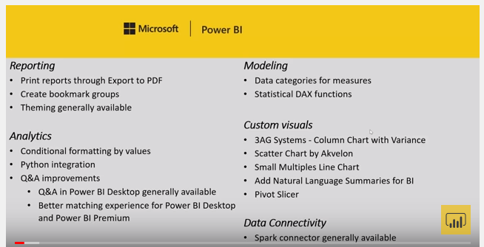
In the 2018 August release Microsoft added Python compatibility
2018 August Feature Summary
Python Episode 1 – A New hope
Notes:
https://powerbi.microsoft.com/en-us/blog/power-bi-desktop-august-2018-feature-summary/
https://powerbi.microsoft.com/en-us/blog/pythonblogepisode1/

Slide 6
In the 2018 August release Microsoft added Python compatibility
Python Developers can connect to the data source in Python, transform the data in pandas and use the Python visuals.
BI Developers should only use Python code when they can’t solve the task by the other languages or features.
Using the GUI of Power BI you can save time coding in Python and add interactivity to reports.
Users need to have Python installed to see Python visuals and to refresh data if Python was used in the query editor.
plt.savefig() as alternate solution.
Notes:
I think the best way to install Python is to use Anaconda. My preferable install path is c:\Anaconda. - This note is for PBI Devs of course.

Slide 7
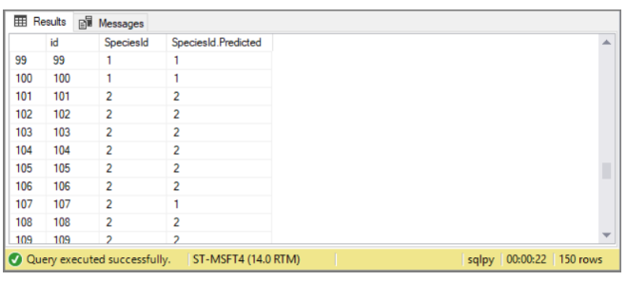
You can run Python scripts on SQL Server 2017
Run Python using T-SQL Tutorial
Machine Learning Tutorial in Python using SQL Server
Notes:
https://docs.microsoft.com/en-us/sql/advanced-analytics/tutorials/run-python-using-t-sql?view=sql-server-2017
https://docs.microsoft.com/en-us/sql/advanced-analytics/tutorials/train-score-using-python-in-tsql?view=sql-server-2017

Slide 8
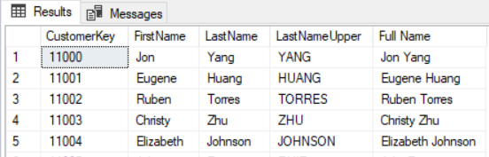
You can run Python scripts on SQL Server 2017
Run Python using T-SQL Tutorial LastNameUpper, Full Name example:
execute sp_execute_external_script
@language = N'Python',
@script = N'
import pandas as pd
MyOutput = MyInput
MyOutput=pd.DataFrame(MyInput)
MyOutput.columns=["CustomerKey","FirstName","LastName"]
MyOutput["LastNameUpper"]=MyOutput["LastName"].apply(lambda x: x.upper())
MyOutput["Full Name"]=MyOutput["FirstName"] + " " + MyOutput["LastName"]
',
@input_data_1_name = N'MyInput',
@input_data_1 = N'SELECT TOP 100 [CustomerKey],[FirstName],LastName FROM [AdventureWorksDW2017].[dbo].[DimCustomer] as [LastName]',
@output_data_1_name = N'MyOutput'
WITH RESULT SETS ( ("CustomerKey" int, "FirstName" nvarchar(max), "LastName" nvarchar(max), "LastNameUpper" nvarchar(max), "Full Name" nvarchar(max)));
GO
Notes:
Example of creating two new calculated columns, Full Name and LastNameUpper

Slide 9
Main Topics
Power BI demo with AdventureWorksDW2017
Investors Exchange (IEX) Developer API accessed with Python script demo report
Programming languages used in Power BI (SQL, M, DAX and Python)
Notes:
Memo to start the AdventureWorks demo – will not be publicly shared
https://pypi.org/project/iexfinance/

Slide 10
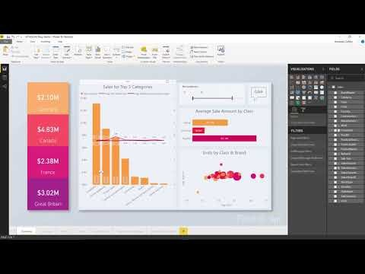
Hasznos linkek:
A Power BI Desktop download
New version in every month
Power BI App from Windows Store (updates automatically)
What's new in the latest Power BI Desktop update?
Previous monthly updates to Power BI Desktop

Slide 11

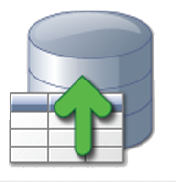


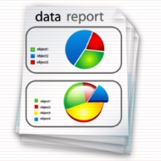
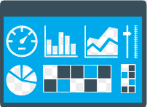



Power BI development steps
Get Data
Data format
Column selection
Filtering, ordering
Row and column manipulation
Modeling
Relationships
Calculated columns
Measures
Hierarchies
Reports and Dashboards
Publish
Check visuals and business values!
or
Notes:
PBI is capable of doing complex ETL tasks.

Slide 12
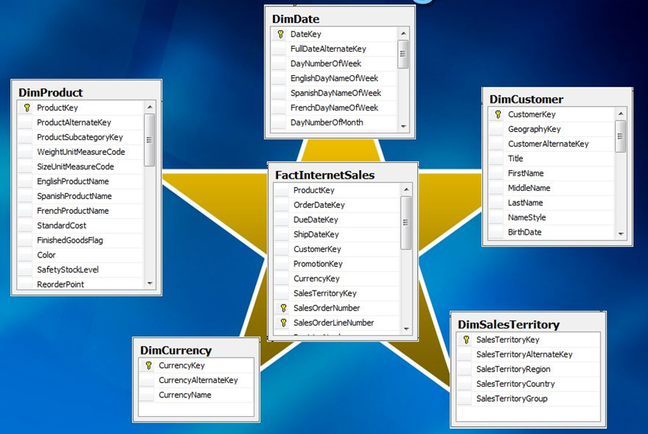
Starchema model - Filter context flow
Fact tables
Business events.
Dimensions
Attributes describing business events.
Tabular models don’t have to strictly follow this model.
Notes:
After setting up the relationships the filter context flows downhill from the lookup/dimension tables to the Fact tables.
You can create a slicer from any of these columns to give interactivity to your reports. Also the users can add slicers to the reports in less than a minute.
It is very useful because the users know the domain the best so they are better at asking the right questions.

Slide 13
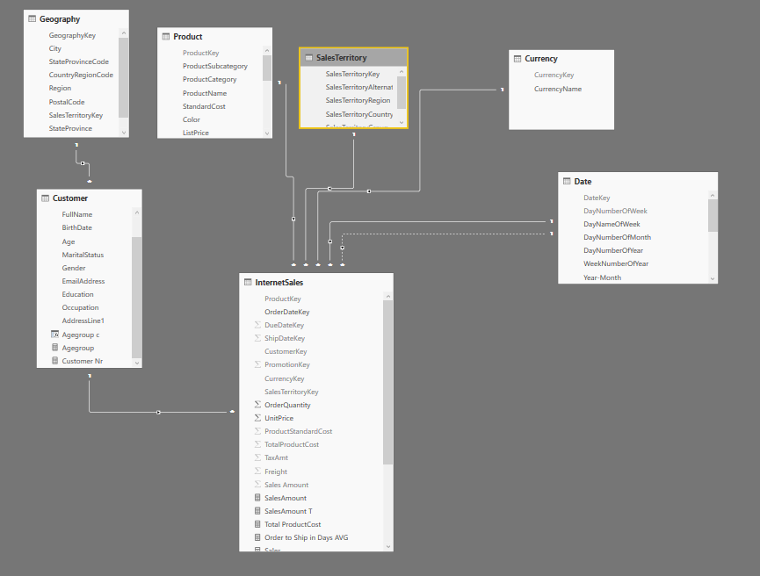
Data model in PBI
Filter context flows downhill to the Fact tables.
Every column can be used as a slicer on a report.
Notes:
Same starchema from the relationship view of a Power BI report
The screenshot above describes a starchema which becomes a snowflake on the Customer - Geography relationship.

Slide 14
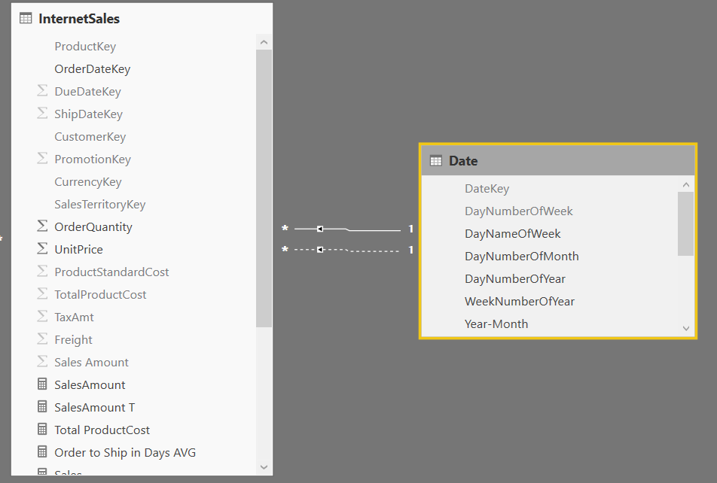
USERELATIONSHIP DAX function
Very often there are multiple dates in a Fact table.
Sometimes different measures should be analyzed by different dates such as shipping cost by the Shipped date.
Shipping Cost by ShipDate = CALCULATE( [Shipping cost]; USERELATIONSHIP(InternetSales[ShipDateKey];'Date'[DateKey]) )
Notes:
Between the Fact table and the dimension only one relationship can be active, we can use the inactive relationship by using the
,USERELATIONSHIP expression.

Slide 15
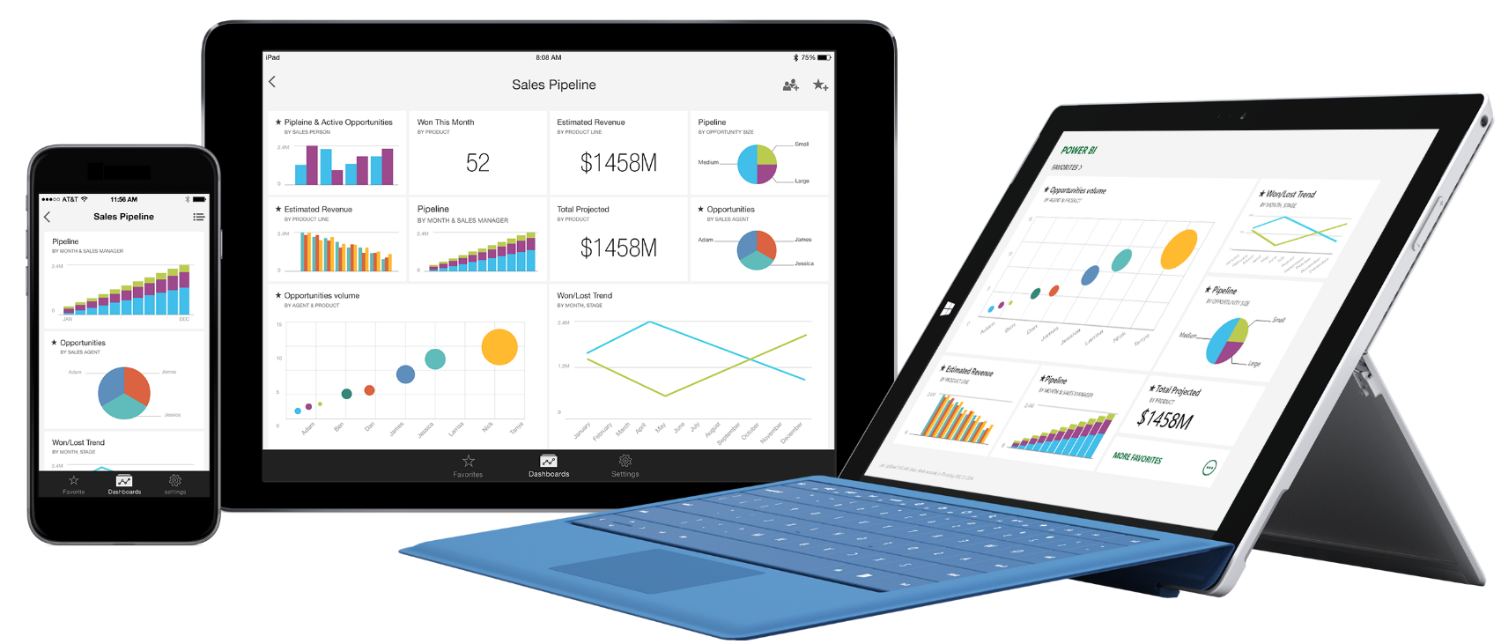
Power BI products
Power BI (Cloud) Service
Power BI Desktop (free)
Power BI Report Server
Power BI Mobile (Windows Phone/Android/iPhone)
Power BI Embedded

Slide 16
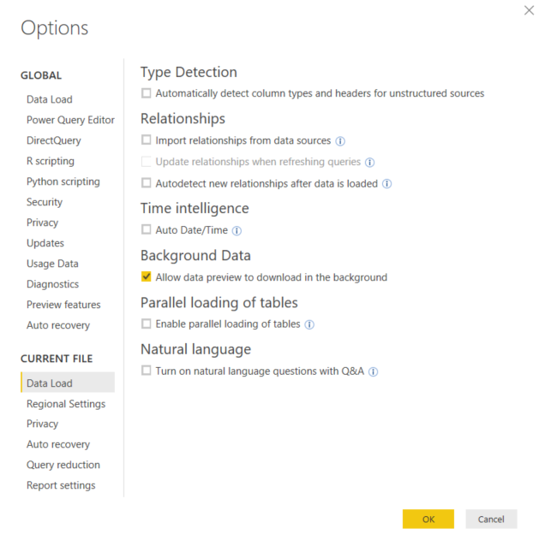
Power BI Desktop Configuration
Global and locale settings
Notes:
This options page is the most important. I personally like to manage the relationships manually and prefer not to use Auto Date/Time.
Memo to start with the iexfinance Python demo.

Slide 17
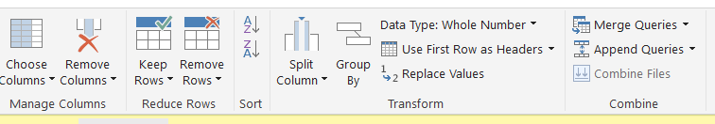
Power Query / Query editor
A Power BI programming languages
Connect to dozens of data source types!
Interface to manage ETL (Extract Transform Load) tasks, query editor in Power BI is mostly the same as power query in Microsoft Excel.
Using the graphical interface, we are writing code in a language called M. We can see the code in the advanceed query editor and in the formula bar.
There are many more functions in M than you can use by using the GUI.

Slide 18
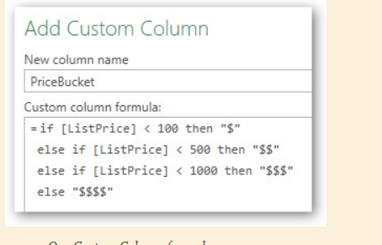
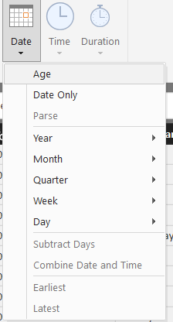
M – Power Query, Query Editor
Useful functions in the Query Editor:
Replace values – Handle Null values Replace M, F with Male, Female
Replace Errors –
UNPIVOT – for example when you have the years in different columns (Practice 1 in lab)
Date from Datetime data type , add Year, Month etc colums from Date

Slide 19
DAX Data Types
DAX data types
Whole Number (Integer) stores a 64 bit value
Decimal Number (Float)
Currency (Currency), a fixed decimal number internally stored as an integer.
Date (DateTime)
Boolean (TRUE/FALSE)
Text (String)
Binary large object (Blob)
Notes:
The point is that DAX data types differ from Python data types.

Slide 20
DAX
First evaluates the filter context, then computes the values.
Sales in Canada = CALCULATE([SalesAmount];Geography[Region]="Canada")
Sales in Berlin capital city= CALCULATE([SalesAmount];Geography[Region]="Germany";Geography[StateProvince]="Hamburg"; Geography[City]="Berlin")
Sales of Bikes and Accessories = CALCULATE([SalesAmount];'Product'[ProductCategory]="Bikes" || 'Product'[ProductCategory]="Accessories" )
Sales under the Queen = CALCULATE([SalesAmount];Geography[Region]="Canada" || Geography[Region]="Australia" || Geography[Region]="United Kingdom" )

Slide 21
General rule about transformation and applying business logic
In regard of performance and maintainability: it is better to do the transformations such as creating full name or a ratio of two numerical values in the source database. Therefore SQL skills are important to have.
DB
Query Editor
DAX
Notes:
Check out Art Tennick’s LinkedIn page if you are interested in other Power BI – Python demos
https://www.linkedin.com/in/arttennick/

Slide 22
Power BI
Python
Notes:
The Prediction level is mostly reached by data science.
My conclusion based my advanced Power BI and beginner Python skills is that for BI tasks I recommend Power BI and Python for serious statistics, predicting, ML tasks.
I would not use Python for creating a basic chart.
Picture source: https://www.slideshare.net/sogeti_nl/bi-symposium-pyramid-28603122

Slide 23
Please experiment combining Python with Power BI and post your results!
Ronai.bertalan@grape.hu
Notes:
If you have demo reports about combining Python and Power BI please post them to the datascientistbudapest Facebook page or my LinkedIn page.
If you have recommendations to improve my demo report, please let me know.

Slide 24
Thanks Python friends!
Ronai.bertalan@grape.hu

